Slide 1






Co-Design of a Hierarchical Assistive Device for Non-Visual Internet Navigation.
PhD Committee:
Ph.D. Jocelyne Kiss
Ph.D. Geoffrey Edwards
Ph.D. Ernesto Morales
Ph.D. Walter Wittich
Juan Nino,
PhD Candidate
Denis Simard
Vice-Dean of

Slide 2
“ Supporting non visual internet navigation, towards a more inclusive internet. ”
Notes:
Presentation of partners

Slide 3
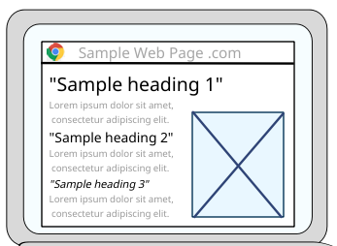
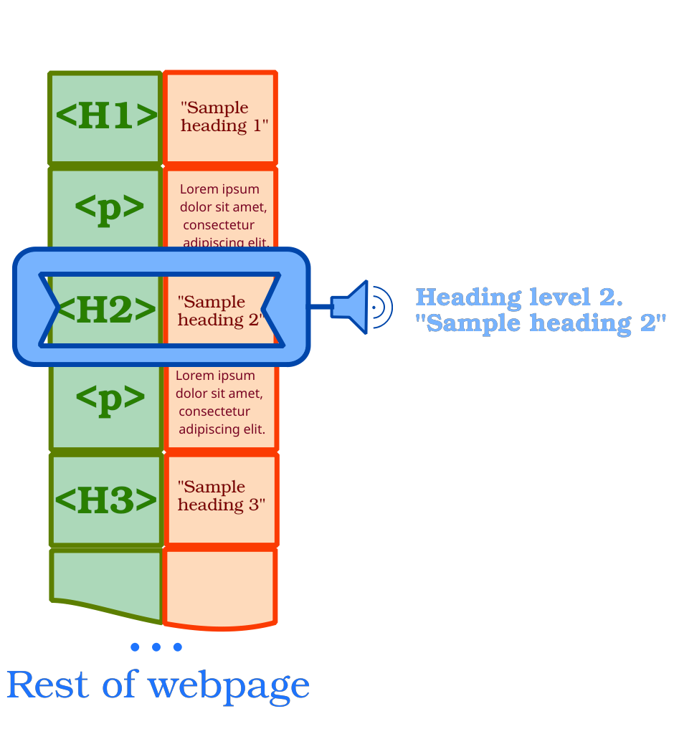
Visual vs Screen Reader Internet Experience.
Visual presentation
Aural presentation
Structure
Content
Screen reader
Structure
Content
Can look anytime at:
Structure & Content
Has to discriminate and remember :
Structure & Content
Notes:
Background: Screen reader is the main assistive technology used by visually impaired internet users. While navigating the web, it voices a list of page elements, which are hard to keep in mind while trying to find your way online. Furthermore, most pages are designed with visual access in mind and do not translate well to screen reader navigation.

Slide 4
Complementing Screen Reader Internet Experience.
SR companion device
Aural presentation
Structural “tactile minimap”
Structure
Content
H1
“Sample heading 1”
“Sample heading 2”
H2
“Sample heading 3”
H3
H3
“Sample heading 3 #2”
H2
Screen reader
“Sample heading 2”
H1
“Sample heading 2”
Can look anytime at:
Structure & Content
Has to discriminate and remember :
Structure & Content
Notes:
The internet is not yet inclusive, and we want to use a tactile device to provide a nonlinear (more information than just a list), persistent (which can be checked anytime) webpage “minimap” adapted for screen reader users.

Slide 5


Main Objective:
CODESIGN an assistive technology to support nonvisual navigation with visually impaired users, clinicians and research team.
Notes:
images: https://www.partsight.org.uk/pss-lapel-badge https://www.shutterstock.com/es/image-vector/social-network-connection-global-business-communication-1683881017

Slide 6
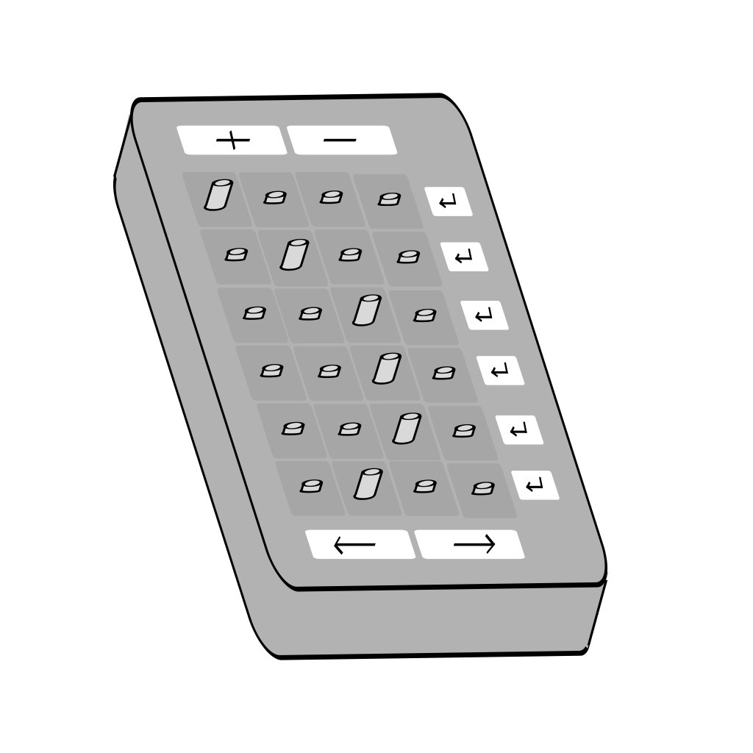
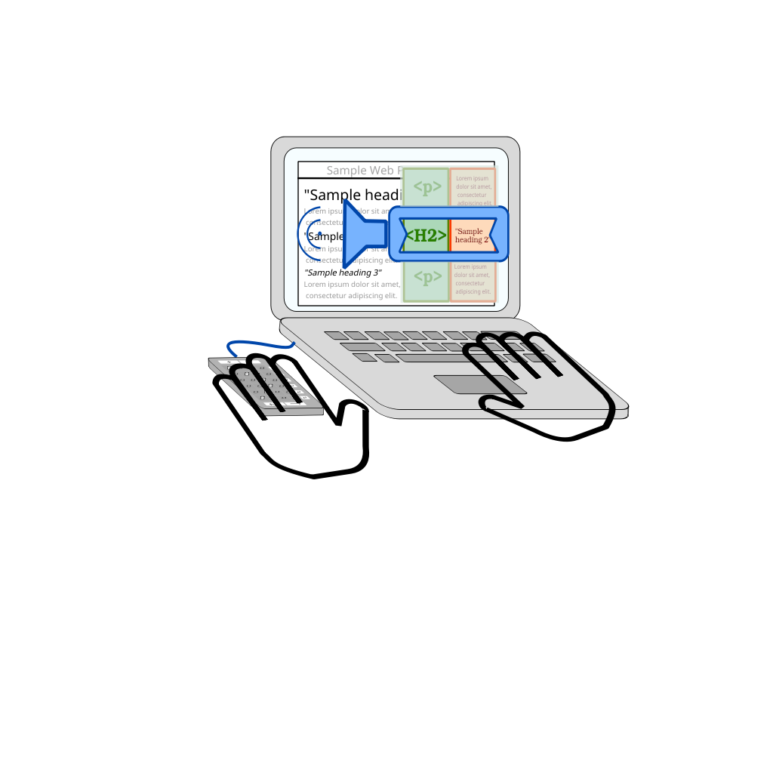
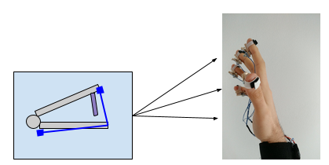
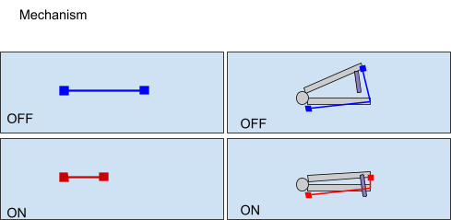
Tactile technology:
Working principle:
Shape memory alloy compresses when electric current is applied.

Slide 7
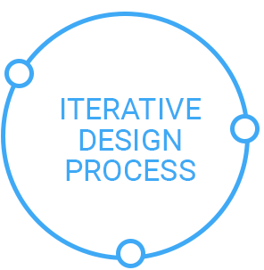
Methodology:
1) Evaluate user needs.
2) Co-Design and build device.
3) Test device in a navigation task.
Evaluation of effect on:
- navigation (time, effort)
- user satisfaction with technology
Notes:
CO-CREATION. Share concept design, codesign with participants, validate device and collect feedback for the next design iteration
CONSTRUCTION-TEST Re-build device based on feedback. User validation and feedback for next iteration.
EXPERIMENTATION n=5 pdv + 2 clinitians. 15 min training, 45 min testing while navigating the web: 1) capacity to navigate, 2) navigation performance, 3) user satisfaction (Quest).
image: https://medium.com/justinmind/the-iterative-design-process-at-tokbox-3b61dd4a9063

Slide 8
Expected Results:
Deliverable: Assistive technology system prototype.
Easier non visual access to online information (leisure, culture, education and work).
Positive implications for autonomy and participation of visually impaired internet users.

Slide 9
Use of Results by Partners:
Prototype and documentation.
User guide for implementing device at partners place.
Workshop for a prototype presentation.
Plan to open source (free & continuous improvement, derivatives and support).
Partner acknowledgment in scientific publications.

Slide 10
References:
Baez, M., Daniel, F., & Casati, F. (2019, November). Conversational Web Interaction: Proposal of a Dialog-Based Natural Language Interaction Paradigm for the Web. In International Workshop on Chatbot Research and Design (pp. 94-110). Springer, Cham.
Fecke, A., Jeleniowski, S., & Joisten, M. (2015). Accessible Websites for the Visually Impaired: Guidelines for Designers. In Mensch & Computer Workshopband (pp. 419–422).
Mahmud, J., Borodin, Y., Das, D., & Ramakrishnan, I. V. (2007, January). Combating information overload in non-visual web access using context. In Proceedings of the 12th international conference on Intelligent user interfaces (pp. 341-344).
Shethia, S., & Techatassanasoontorn, A. A. (2019). Experiences of People with Visual Impairments in Accessing Online Information and Services: A Systematic Literature Review. Pacific Asia Journal of the Association for Information Systems, 11(2).
Web Accessibility in Mind. (2019). WebAIM: Screen Reader User Survey# 8 Results. Online at https://webaim.org/projects/screenreadersurvey8/ accessed: Sept 2021.
Notes:
However, navigating a web page still represents a challenge today for visually impaired users (Shethia & Techatassanasoontorn, 2019). Web developers often lack awareness and expertise on designing accessible websites and often ignore how different users might interact with their websites (Fecke, Jeleniowski, & Joisten, 2015)⁠⁠ .
Currently, the most common technology for assisting internet navigation is the screen-reader, and around 80% of screen reader users operate exclusively with audio (Web Accessibility in Mind, 2019).
Because most web developers design pages with visual access in mind, (Mahmud et. al, 2007) sighted users are visually presented with a web page rich in information; which does not translate well to the aural representation from the screen reader (Baez et al, 2019).

Slide 11
Images:
https://www.partsight.org.uk/pss-lapel-badge
https://www.shutterstock.com/es/image-vector/social-network-connection-global-business-communication-1683881017
https://medium.com/justinmind/the-iterative-design-process-at-tokbox-3b61dd4a9063
Notes:
However, navigating a web page still represents a challenge today for visually impaired users (Shethia & Techatassanasoontorn, 2019). Web developers often lack awareness and expertise on designing accessible websites and often ignore how different users might interact with their websites (Fecke, Jeleniowski, & Joisten, 2015)⁠⁠ .
Currently, the most common technology for assisting internet navigation is the screen-reader, and around 80% of screen reader users operate exclusively with audio (Web Accessibility in Mind, 2019).
Because most web developers design pages with visual access in mind, (Mahmud et. al, 2007) sighted users are visually presented with a web page rich in information; which does not translate well to the aural representation from the screen reader (Baez et al, 2019).

